Slide 1

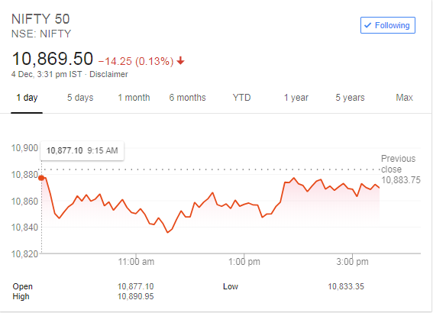
Search…
Home
Dashboard
Research
Blogs
CURRENCY
INDICES
TOP LOSERS
TOP GAINERS

